Slide 1
V
f
λ

Slide 2
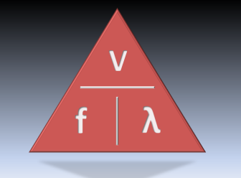
Answers
The speed of a wave with a frequency of 10kHz and a wavelength of 2m.
v = f x λ
v = 10,000 x 2
v = 20,000m/s

Slide 3
Answers
The speed of a wave with a wavelength of 50cm and a frequency of 4kHz
v = f x λ
v = 4,000 x 0.5
v = 2,000m/s

Slide 4
Answers
The frequency of a wave travelling at 500m/s with a wavelength of 25m
f = v ÷ λ
f = 500 ÷ 25
f = 20Hz

Slide 5
Answers
The speed of a radio wave with a wavelength of 3000m and a frequency of 100kHz
v = f x λ
v = 100,000 x 3000
v = 3,000,000m/s

Slide 6
Answers
The speed of a wave with a frequency of 30MHz and wavelength of 10m
v = f x λ
v = 30,000,000 x 10
v = 300,000,000m/s

Slide 7
Answers
The wavelength of a wave travelling at 11km/s with a frequency of 5.5kHz
λ = v ÷ f
λ = 11,000 ÷ 5,500
λ = 2m

Slide 8
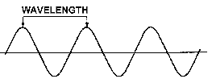
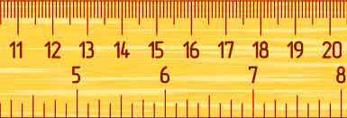
Answers
The frequency of the wave below, which is travelling at 9km/s
f = v ÷ λ
f = 9,000 ÷ 0.03
f = 300,000Hz
or
300kHz
3cm = 0.03m

Slide 9

Wave
Calculations
Wave
Calculations
Wave
Calculations
Calculate the following:
The speed of a wave with a frequency of 10kHz and a wavelength of 2m.
The speed of a wave with a wavelength of 50cm and a frequency of 4kHz
The frequency of a wave travelling at 500m/s with a wavelength of 25m
The speed of a radio wave with a wavelength of 3000m and a frequency of 100kHz
The speed of a wave with a frequency of 30MHz and wavelength of 10m
The wavelength of a wave travelling at 11km/s with a frequency of 5.5kHz
The frequency of the wave below, which is travelling at 9km/s
Calculate the following:
The speed of a wave with a frequency of 10kHz and a wavelength of 2m.
The speed of a wave with a wavelength of 50cm and a frequency of 4kHz
The frequency of a wave travelling at 500m/s with a wavelength of 25m
The speed of a radio wave with a wavelength of 3000m and a frequency of 100kHz
The speed of a wave with a frequency of 30MHz and wavelength of 10m
The wavelength of a wave travelling at 11km/s with a frequency of 5.5kHz
The frequency of the wave below, which is travelling at 9km/s
Calculate the following:
The speed of a wave with a frequency of 10kHz and a wavelength of 2m.
The speed of a wave with a wavelength of 50cm and a frequency of 4kHz
The frequency of a wave travelling at 500m/s with a wavelength of 25m
The speed of a radio wave with a wavelength of 3000m and a frequency of 100kHz
The speed of a wave with a frequency of 30MHz and wavelength of 10m
The wavelength of a wave travelling at 11km/s with a frequency of 5.5kHz
The frequency of the wave below, which is travelling at 9km/s

